Slide 1


Slide 2
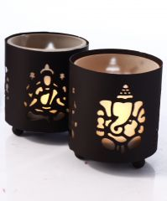
Name : Laxmi Ganesh T light Holder
Size: 3 X 4 Inch
Price : 125
MOQ: 24

Slide 3
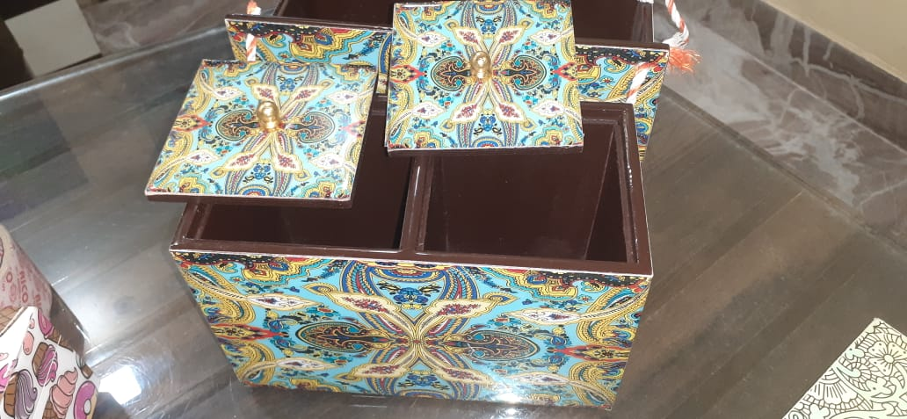
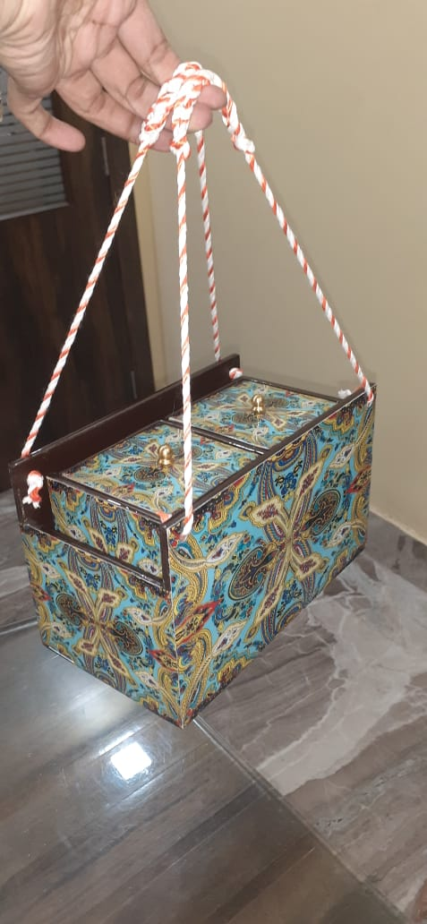
Name: Wooden dry fruit box
Size : 7×8×5
Price : 850
MOQ : 12 Note : Print May Vary

Slide 4
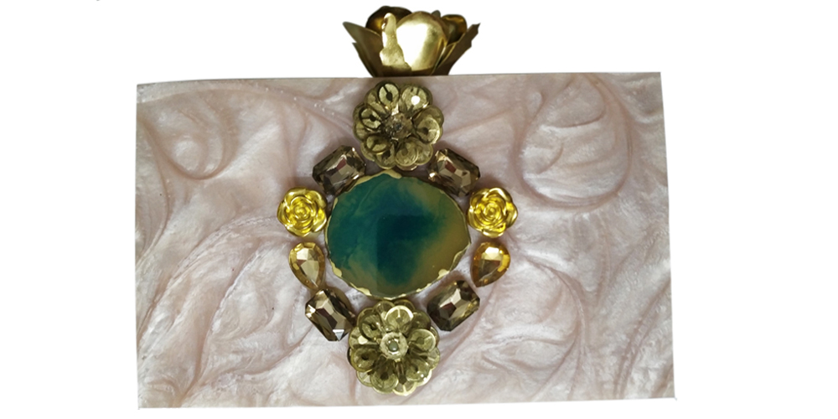
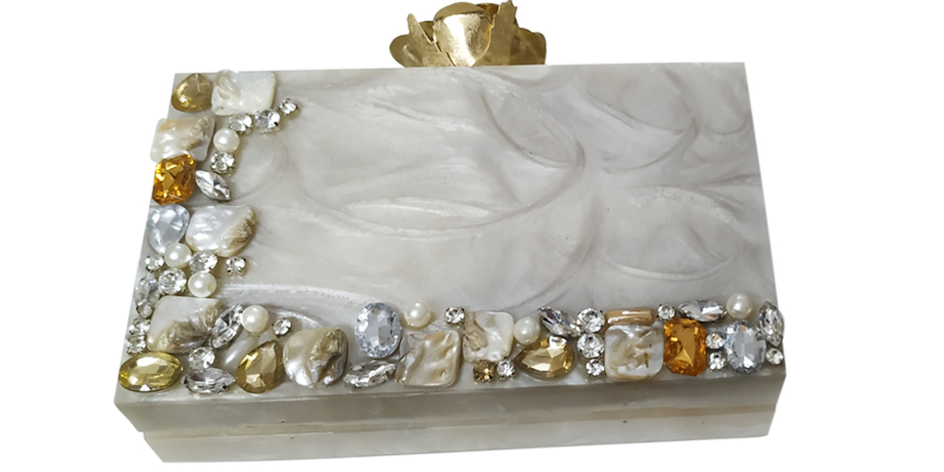
Name : Resin Clutch ( Peach & Cream )
Size: 8×5×2
Price : 900
MOQ: 12

Slide 5
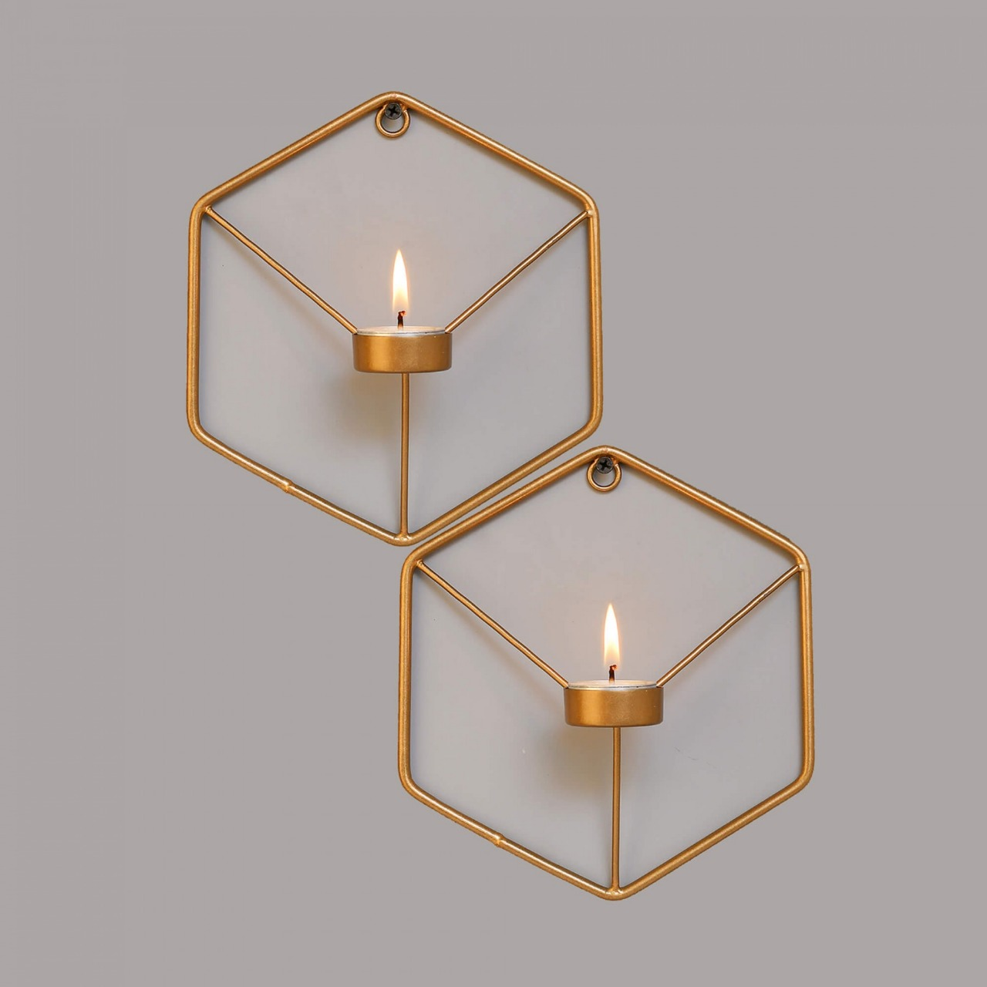
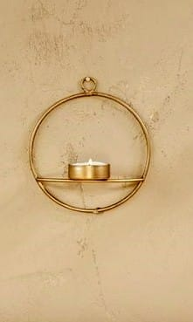
Name : Hexagon –T light Holder
Size: 6X6 Inch
Price : 100 Per set
MOQ: 24
Name : Round-T light Holder
Size: 6X6 Inch
Price : 100 Per set
MOQ: 24

Slide 6
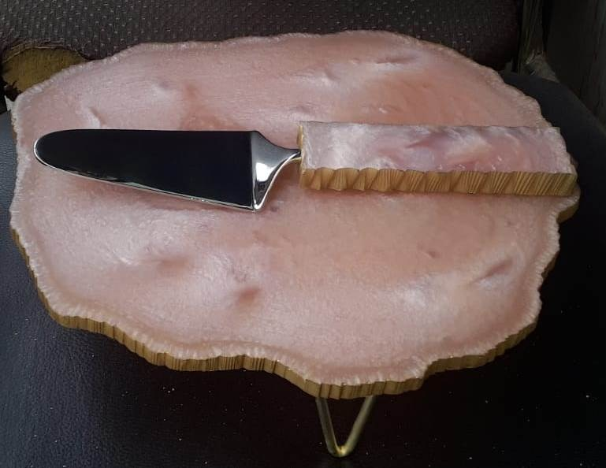
Name:- Cake or Dessert Platter
Size :- 10 X 7
Price : 850 MOQ:- 12

Slide 7
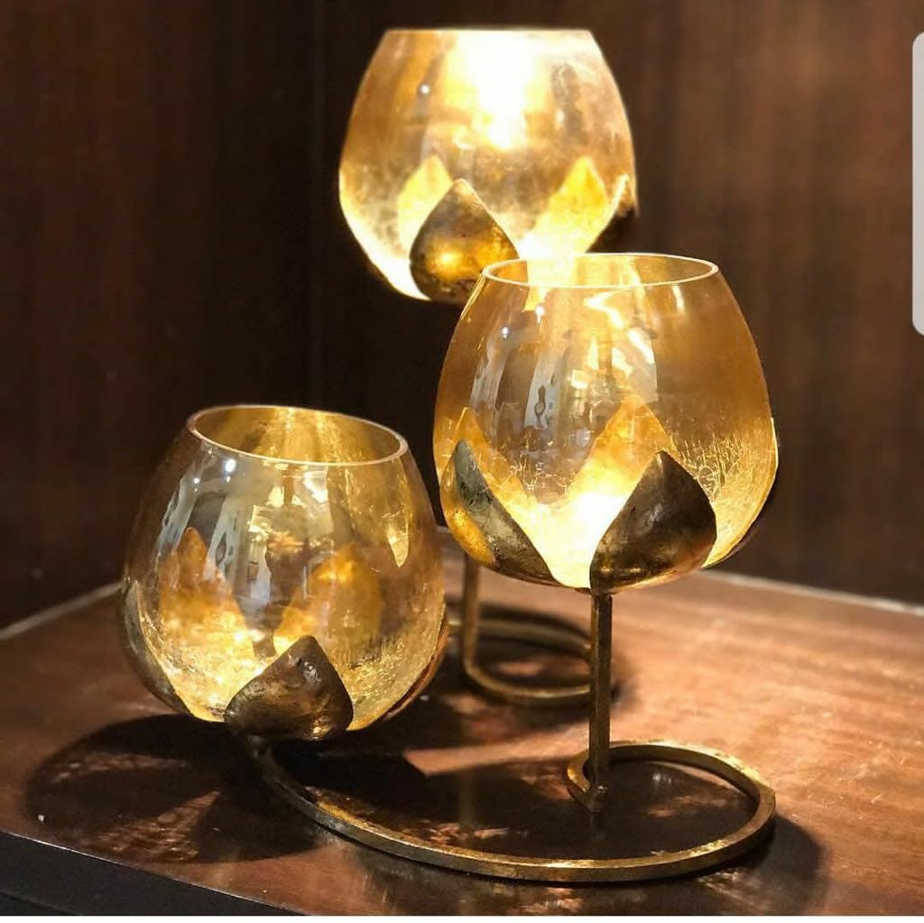
Name: 3 lotus - Tlight Holder
Size :NA
Price : 550
MOQ: 24

Slide 8
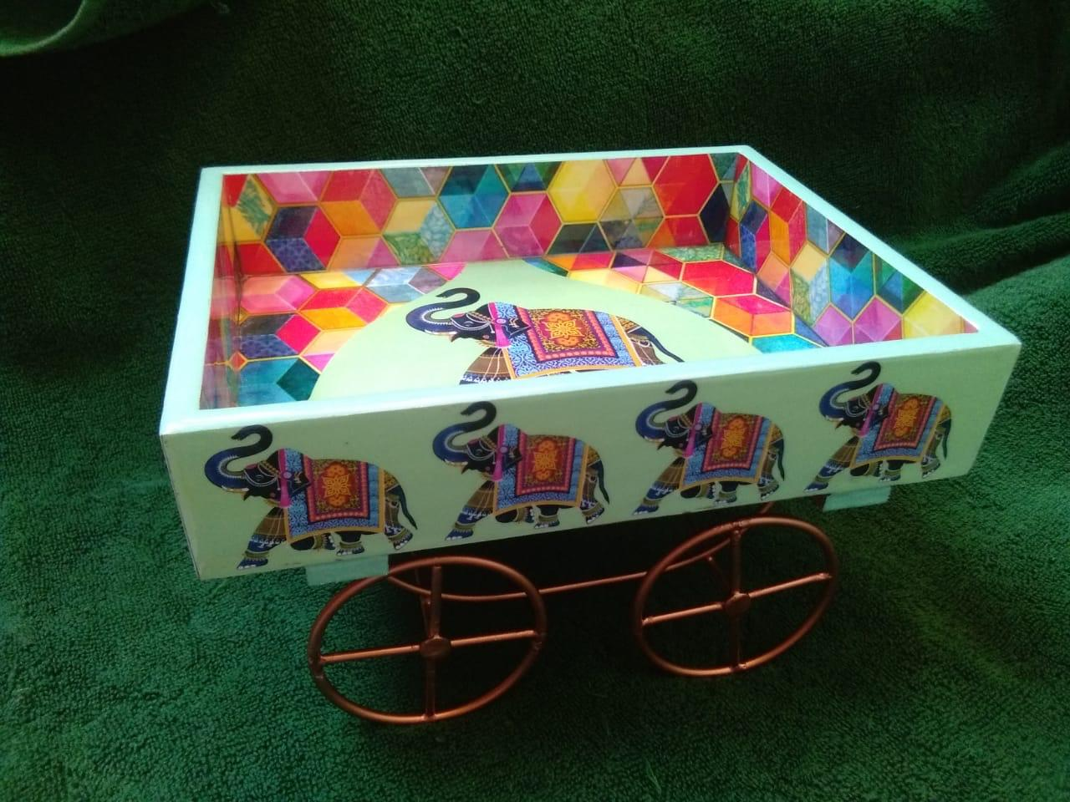
Name: Serving Thela Platter
Size : 8 X 6
Price: 500
MOQ: 24
Note : Print May Vary

Slide 9
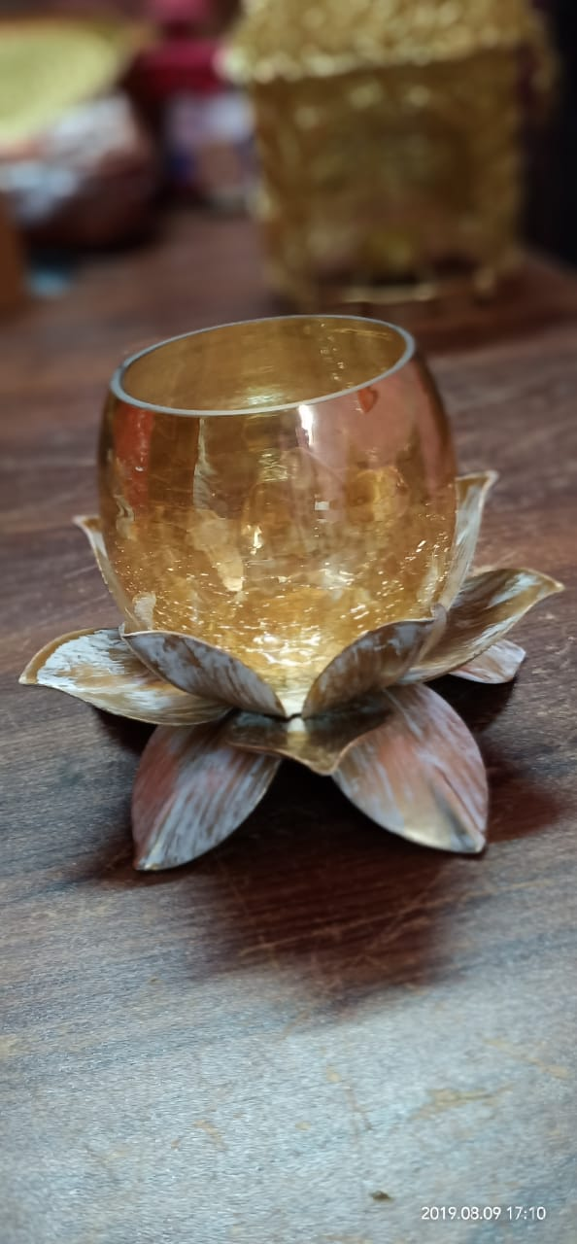
Name: Single Lotus.
Size: 3 Inch Glass
Price : 140
MOQ : 24

Slide 10
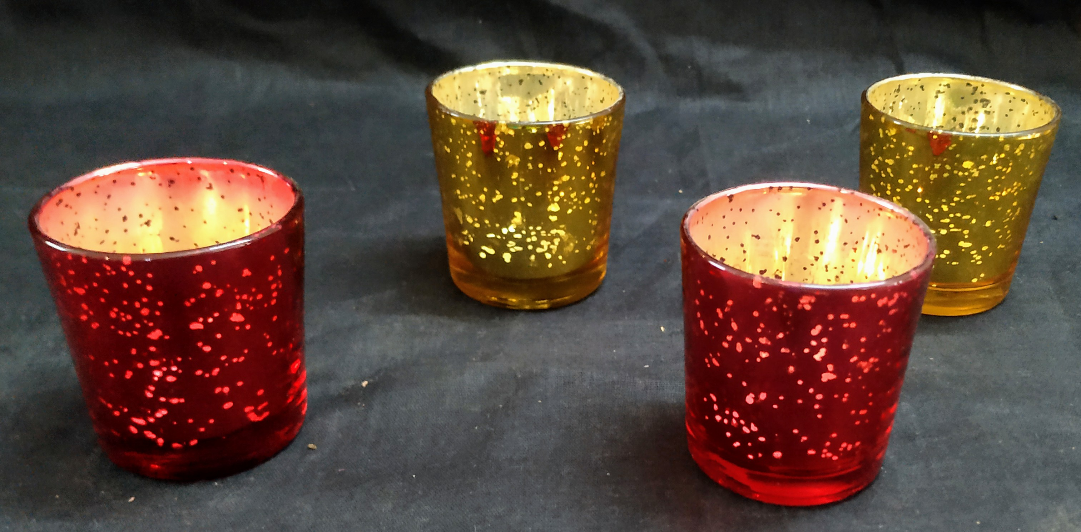
Name : T- Lights Glass Holder
Size: NA
Price : 90 per set
MOQ: 24

Slide 11
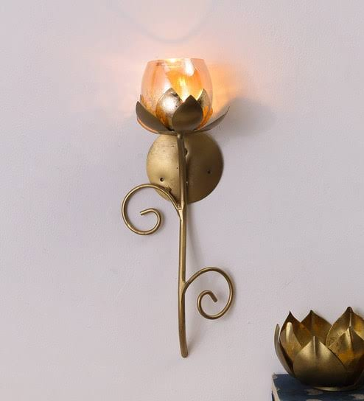
Name: Single lotus wall mounted
Size :15”
Price : 350
MOQ:- 24

Slide 12
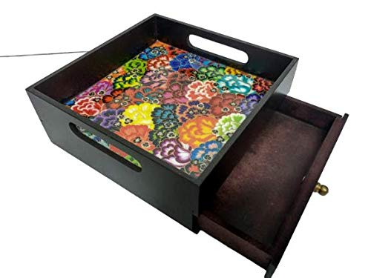
Name: Wooden Serving Tray
Size: 8*8*4
Price : 450
MOQ : 24
Note : Print May Vary

Slide 13
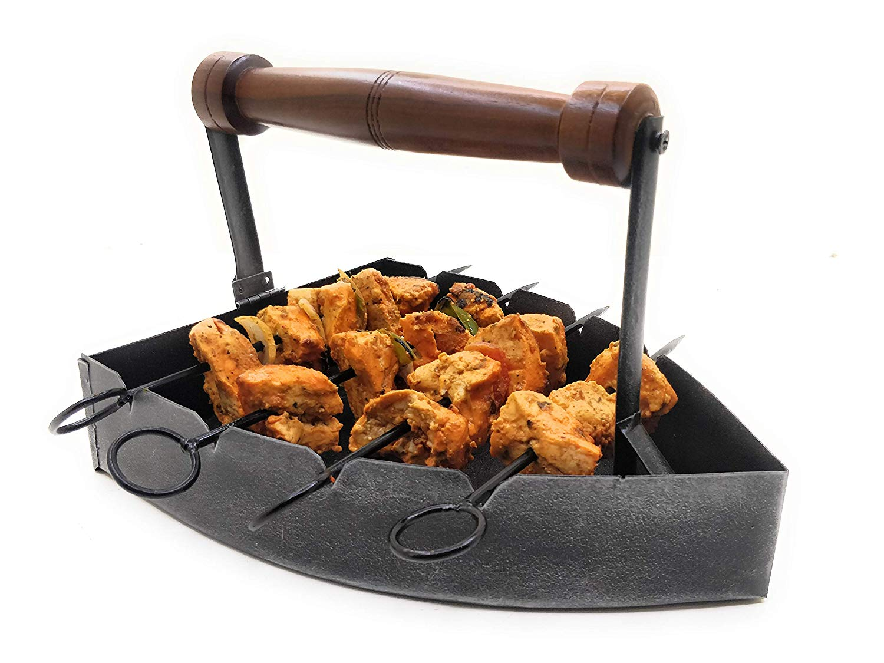
Name: Press Shape Platter
Size: 10*8
Price: 450
MOQ: 12

Slide 14
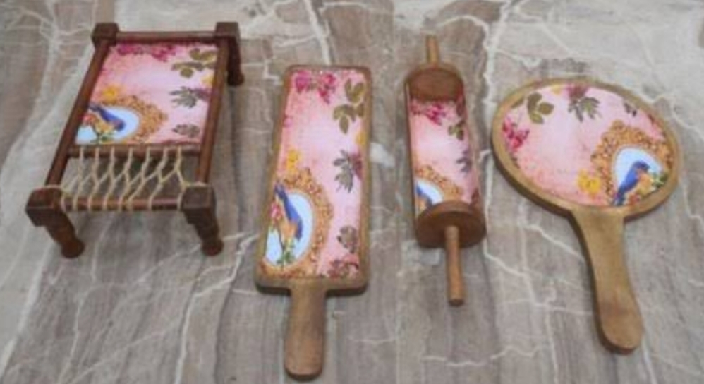
Name : Desi Serving Platters
( Khaat , Belan , Bat & Pizza )
Size : Lenth of Each is minimum
12 inch
Price : 1900
MOQ : 12

Slide 15
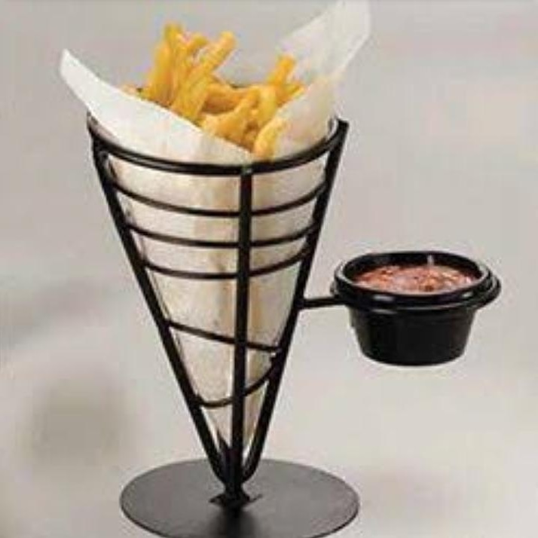
Name: Cone Serving
Size: NA
Price : 170
MOQ :- 24

Slide 16
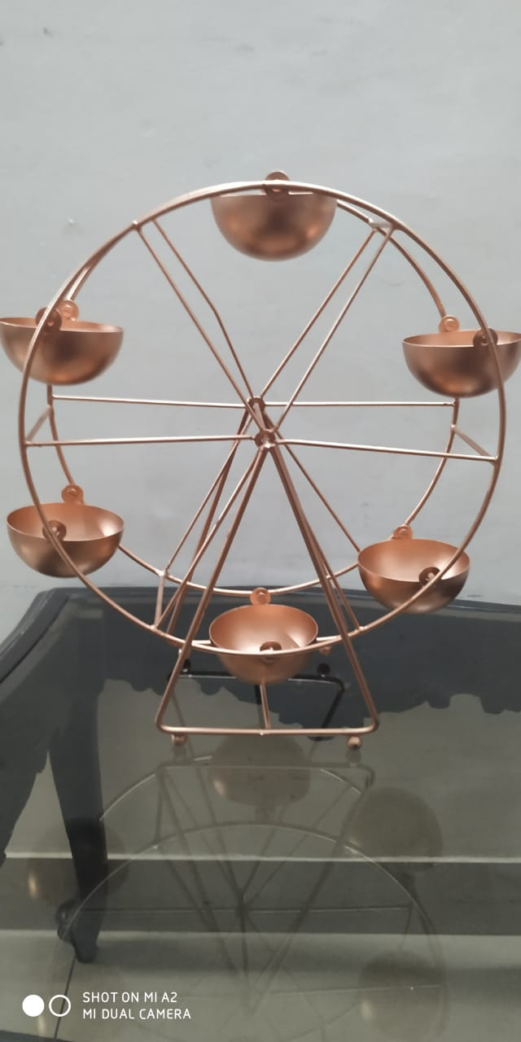
Name : Revolving Wheel For T Light
Size : 12’
Price : 500
MOQ : 12

Slide 17
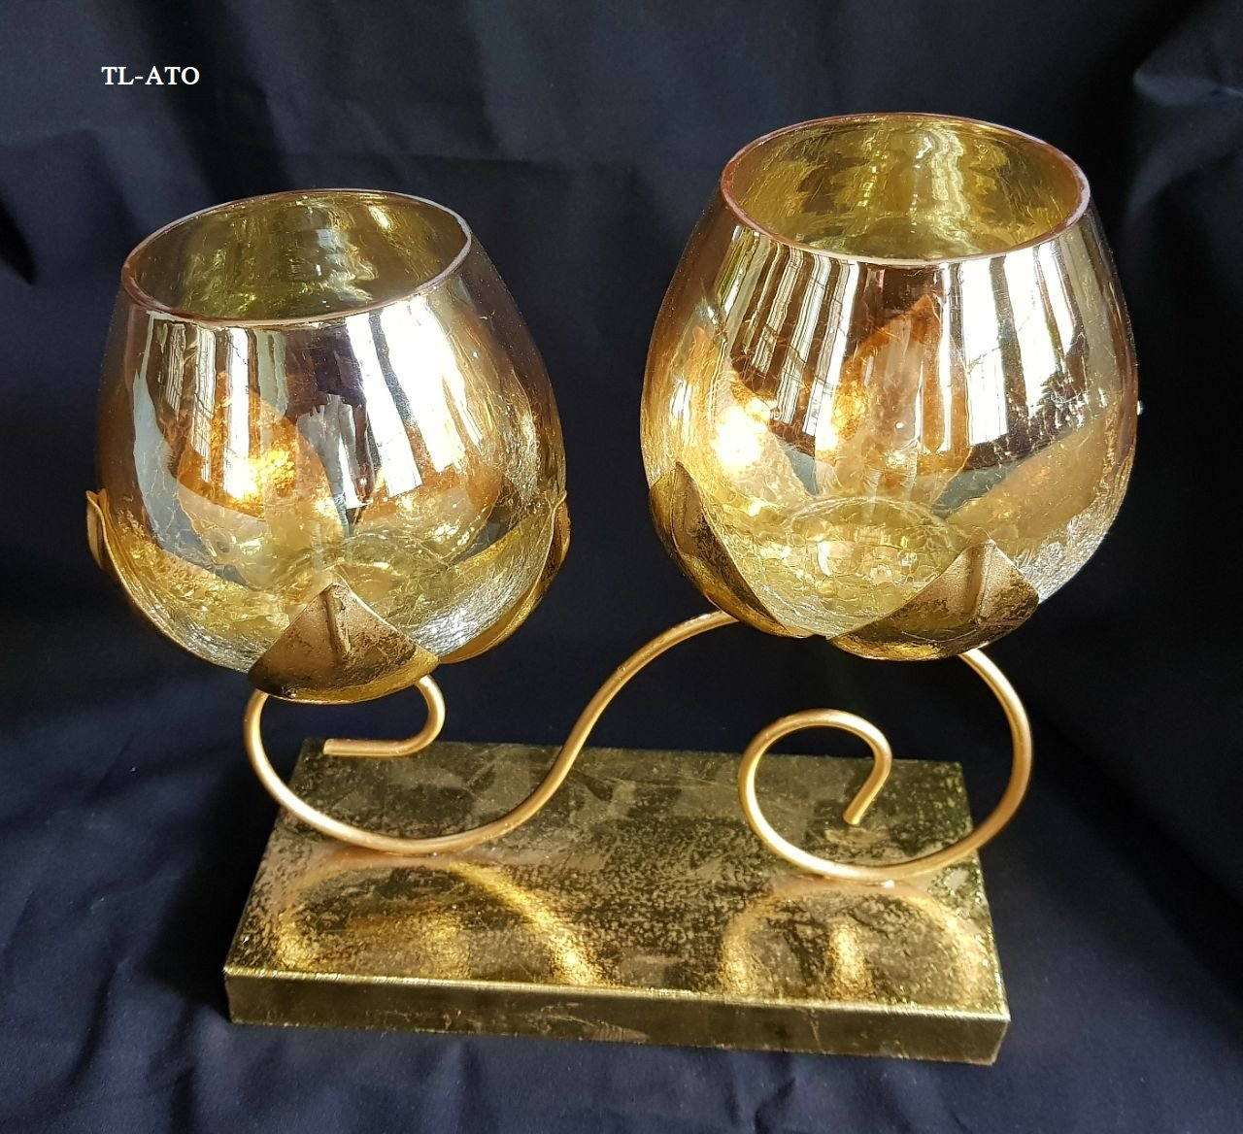
Name :2 lotus T-light Holder
Size : NA
Price :400
MOQ :12

Slide 18
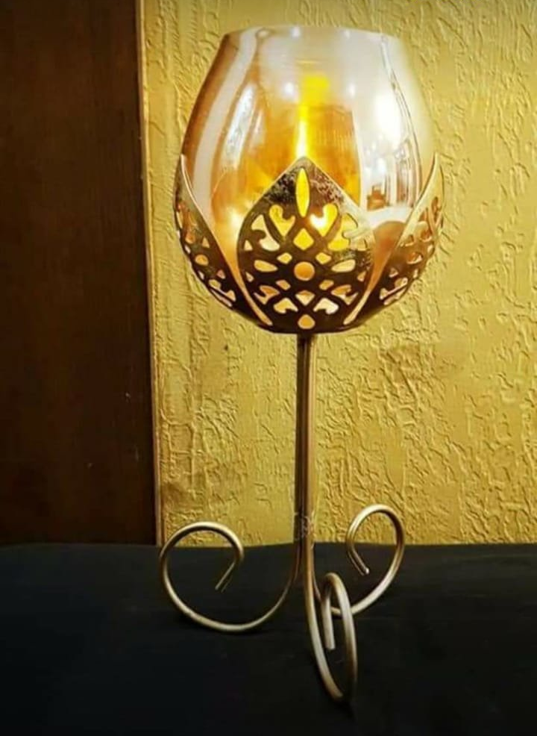
Name : Single Lotus Stand
Size :12’
Price : 210
MOQ : 24

Slide 19
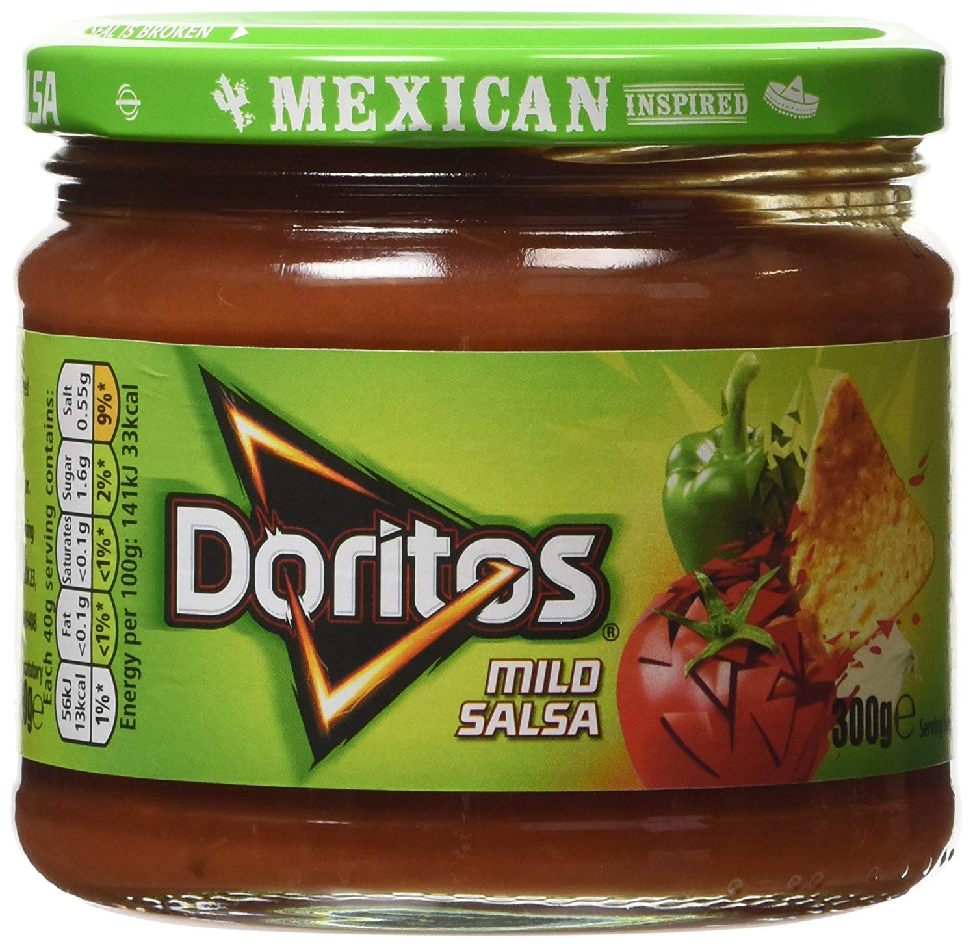
Name : Salsa Jar
Size : 350 ml
Price : 25
MOQ :- 36

Slide 20
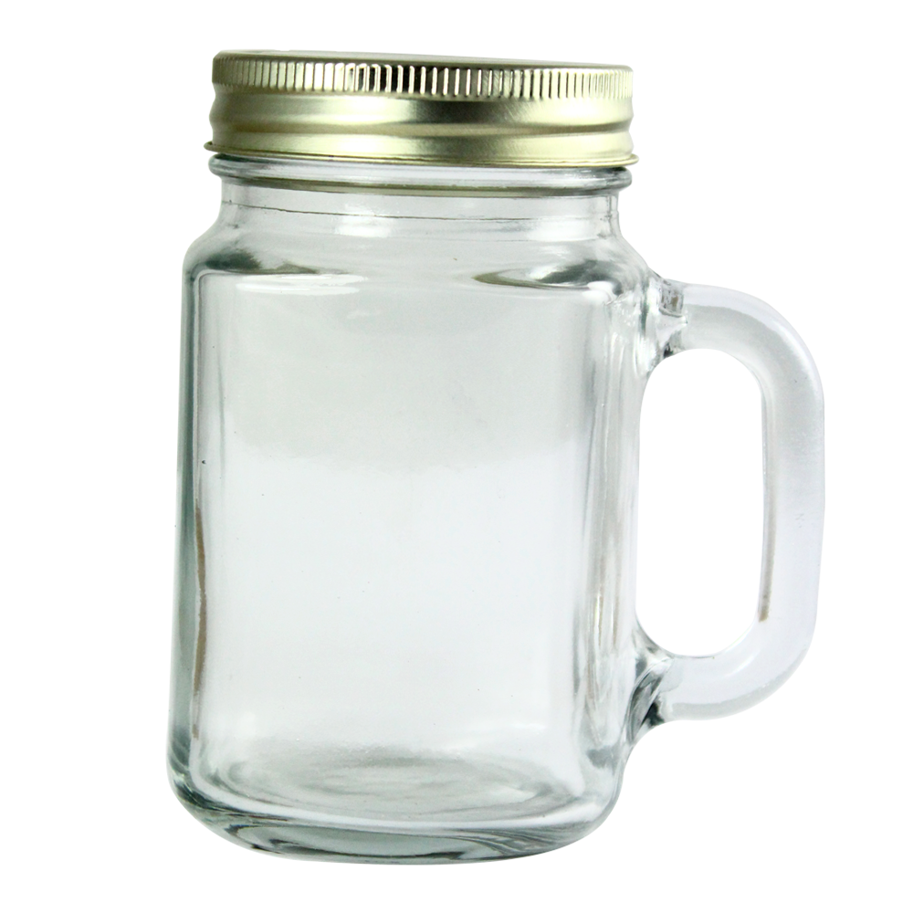
Name : Mason Jar
Size : 550 ml
Price : 40
MOQ : 24

Slide 21
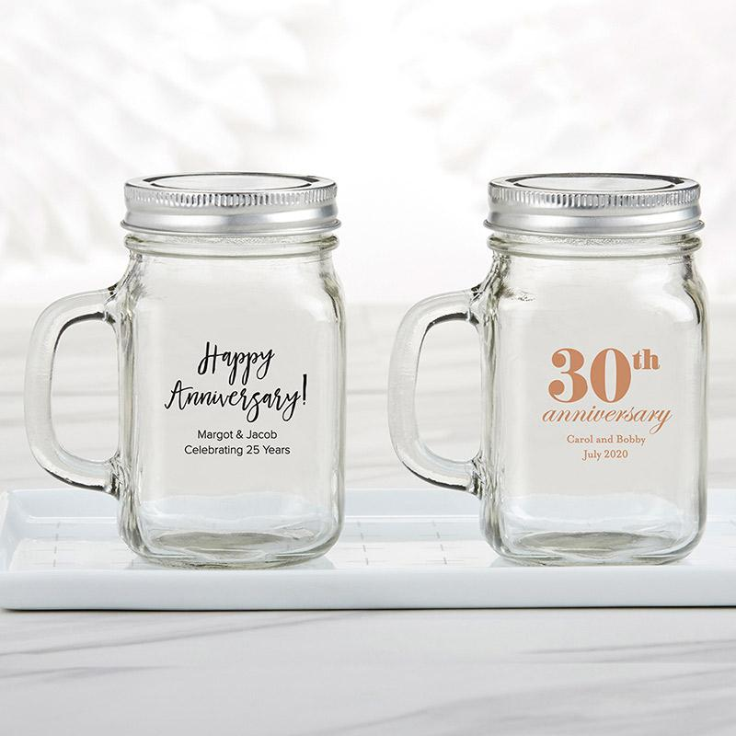
Name : Mason Jar small
Size :150 ml
Price : 25
MOQ : 50

Slide 22
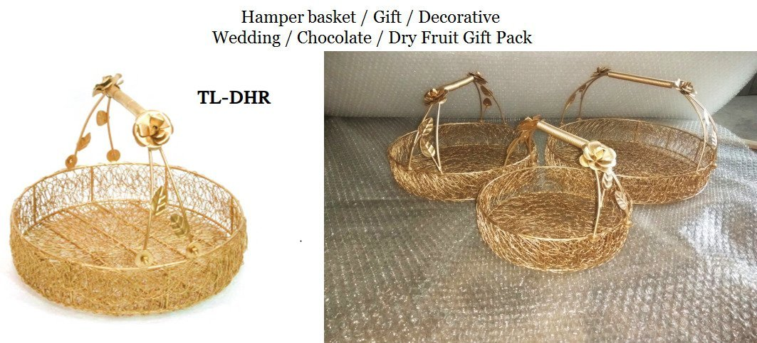
Name : Round bucket
Size :NA
price : 450
MOQ : 12

Slide 23
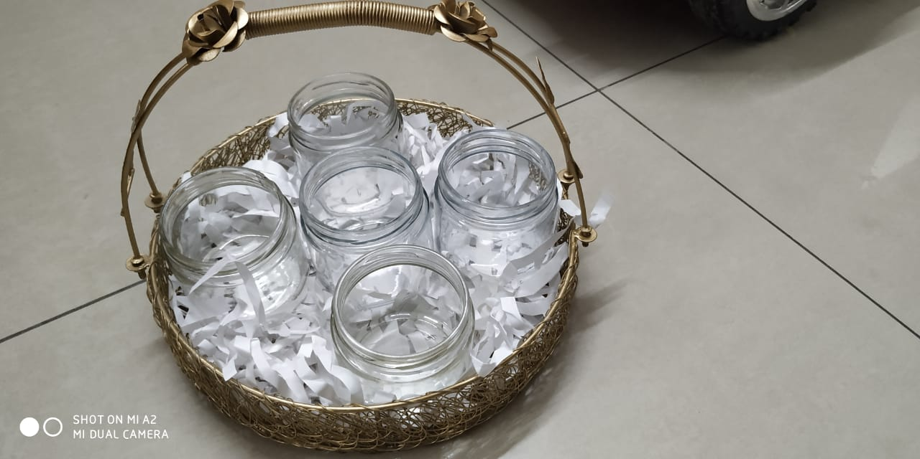
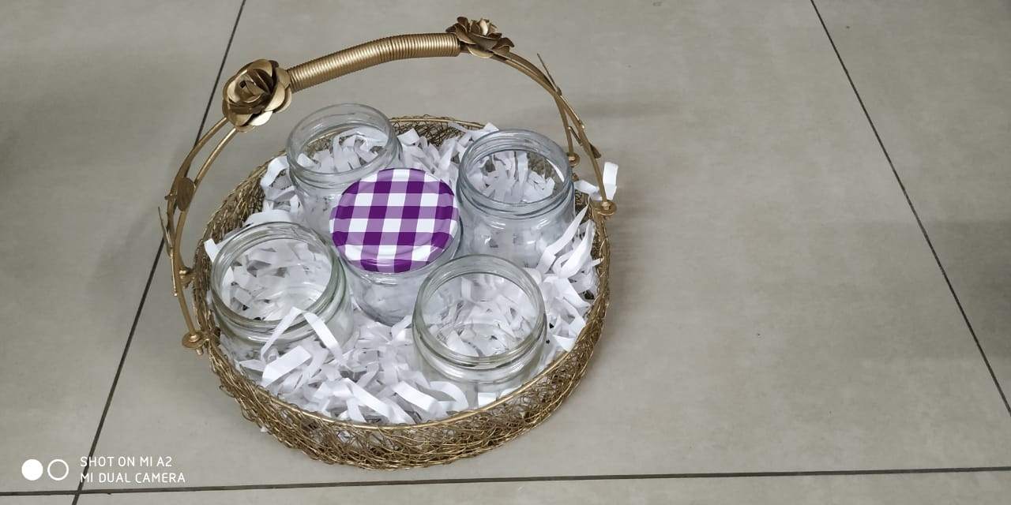

Slide 24
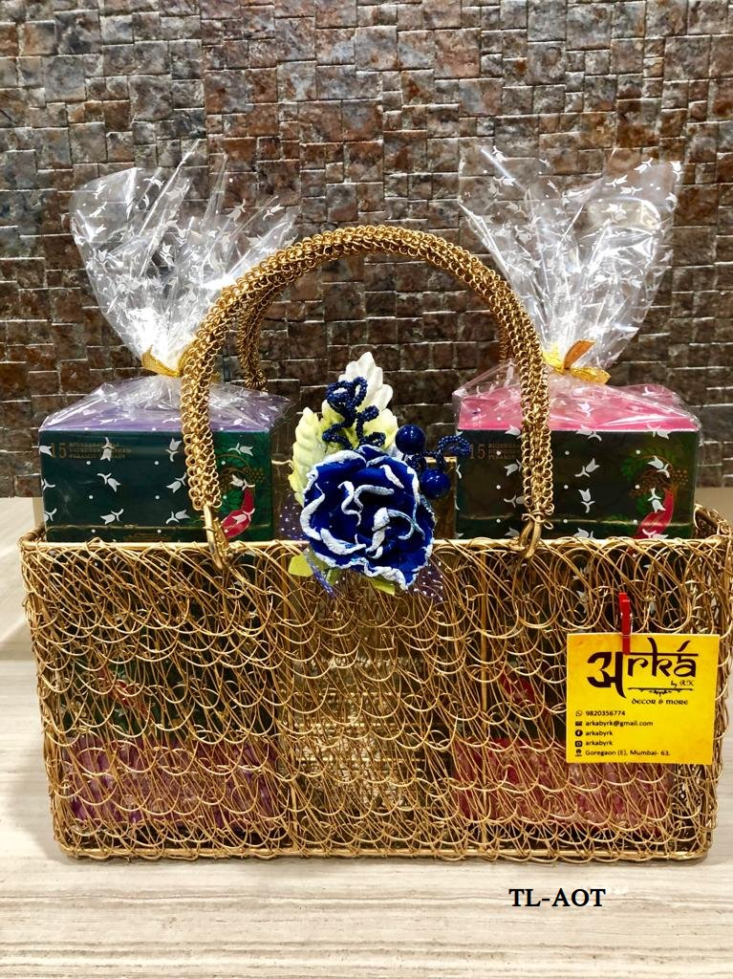
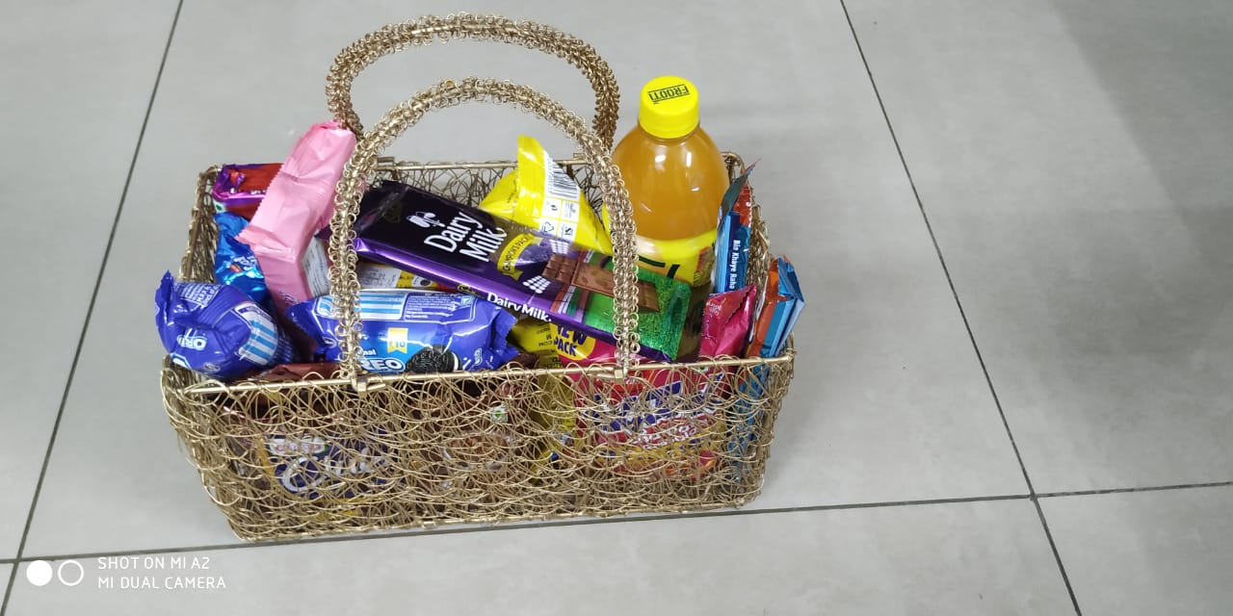
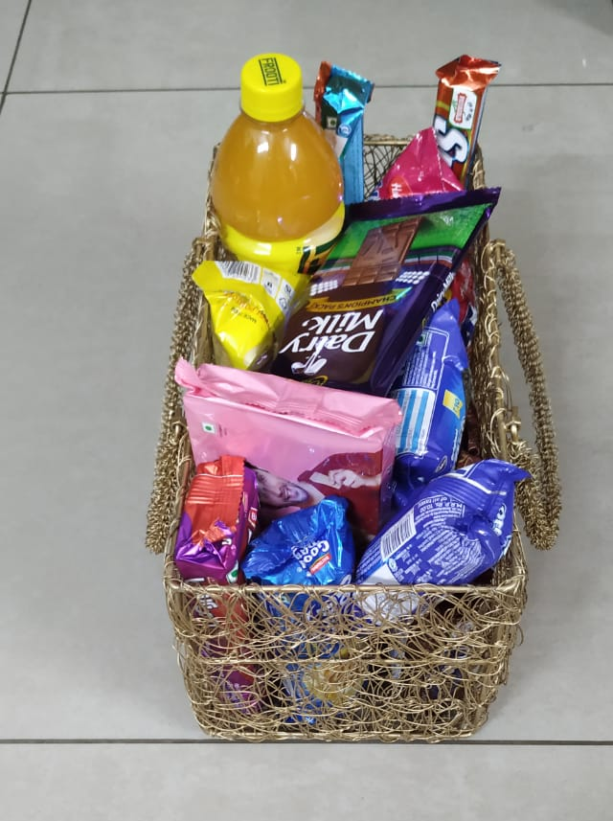
Name : Round Basket
Size :12*6*6
price : 450
MOQ : 12

Slide 25
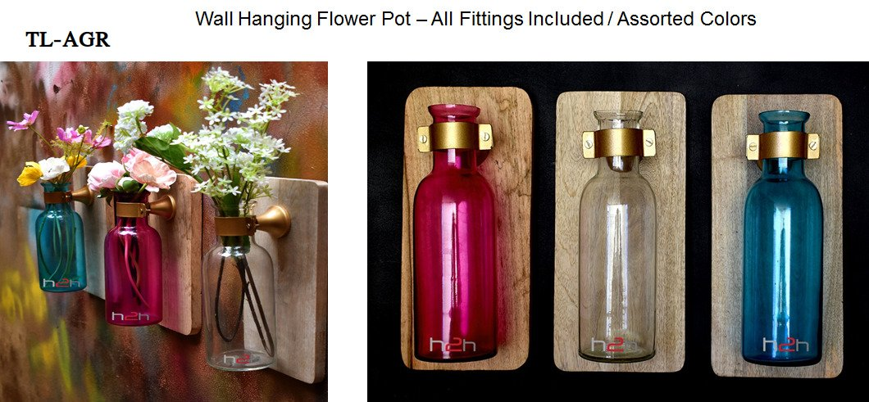
Name : Wooden Glass Flower Pot Size :1 L Price :500 MOQ : 12

Slide 26
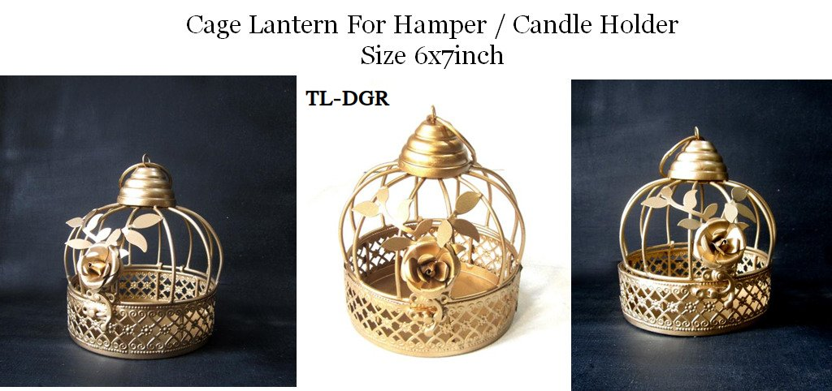
Name : Cage Hamper Size : 8 X 6 price :225 MOQ : 12

Slide 27
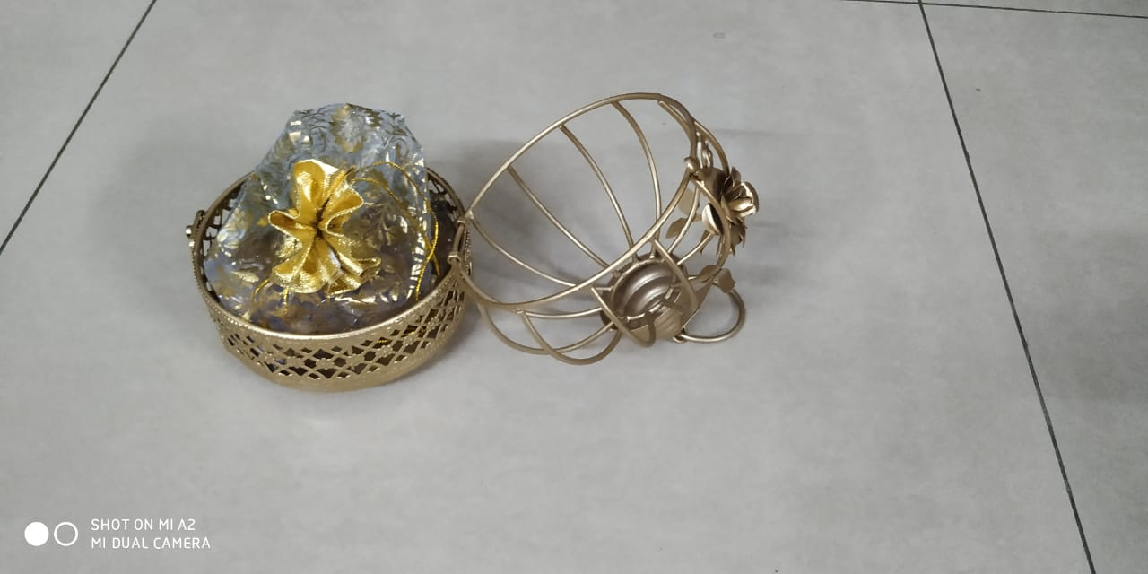
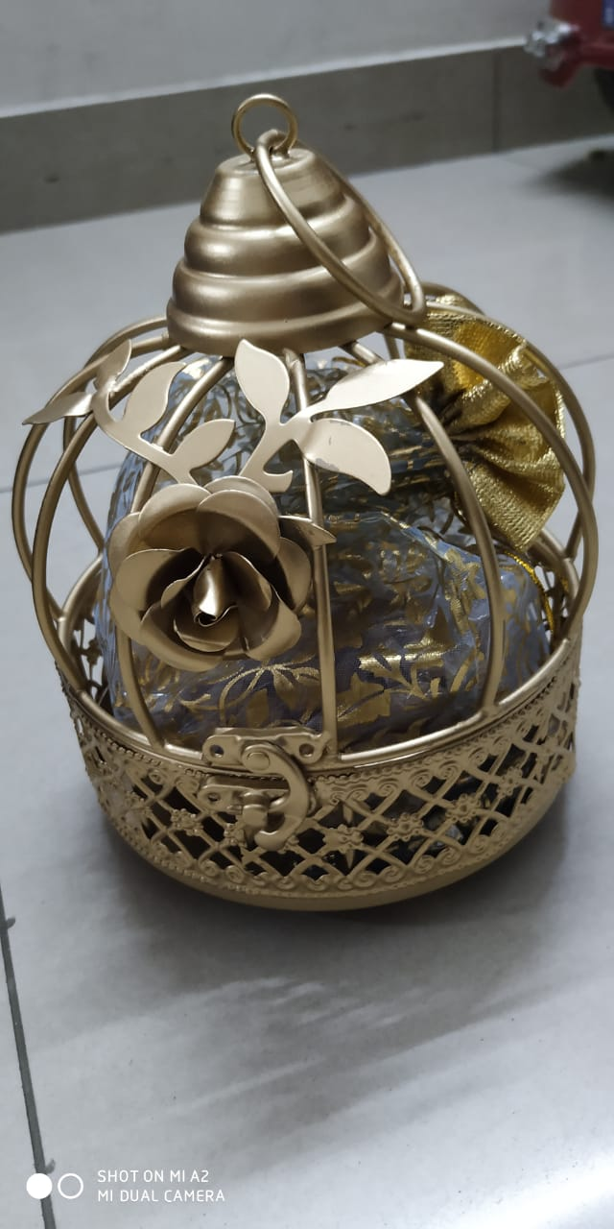

Slide 28
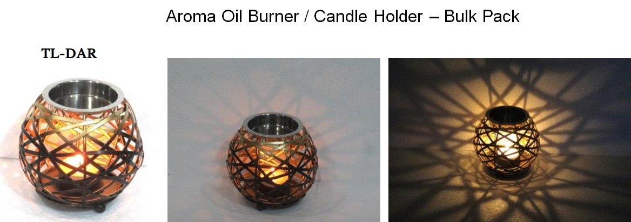
Price :180
MOQ :12

